Slide 1
Introduction
Chapter 1
1.1 What is an operating system
1.2 History of operating systems
1.3 The operating system zoo
1.4 Computer hardware review
1.5 Operating system concepts
1.6 System calls
1.7 Operating system structure

Slide 2
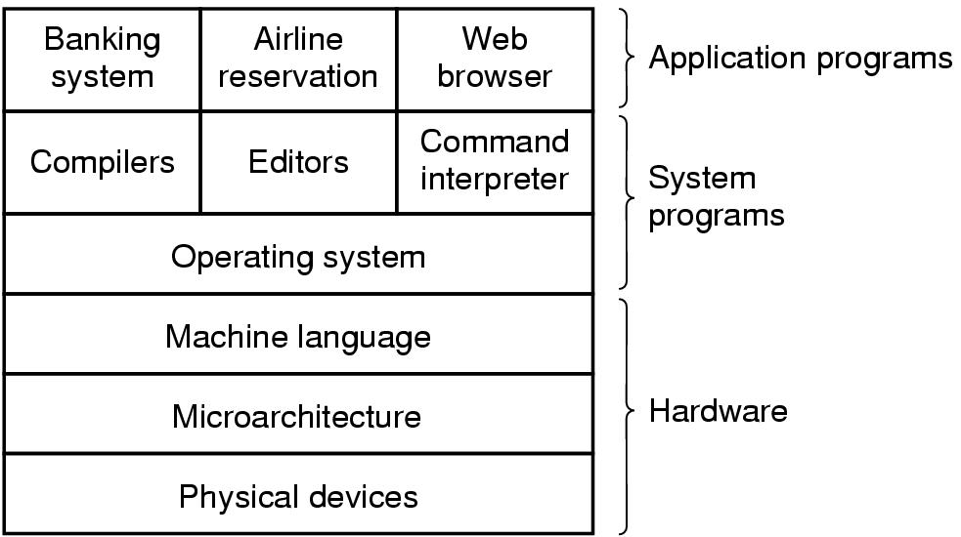
Introduction
A computer system consists of
  hardware
  system programs
  application programs

Slide 3
What is an Operating System
It is an extended machine
  Hides the messy details which must be performed
  Presents user with a virtual machine, easier to use
It is a resource manager
  Each program gets time with the resource
  Each program gets space on the resource

Slide 4

History of Operating Systems
Early batch system
  bring cards to 1401
  read cards to tape
  put tape on 7094 which does computing
  put tape on 1401 which prints output

Slide 5
History of Operating Systems
First generation 1945 - 1955
  vacuum tubes, plug boards
Second generation 1955 - 1965
  transistors, batch systems
Third generation 1965 – 1980
  ICs and multiprogramming
Fourth generation 1980 – present
  personal computers

Slide 6
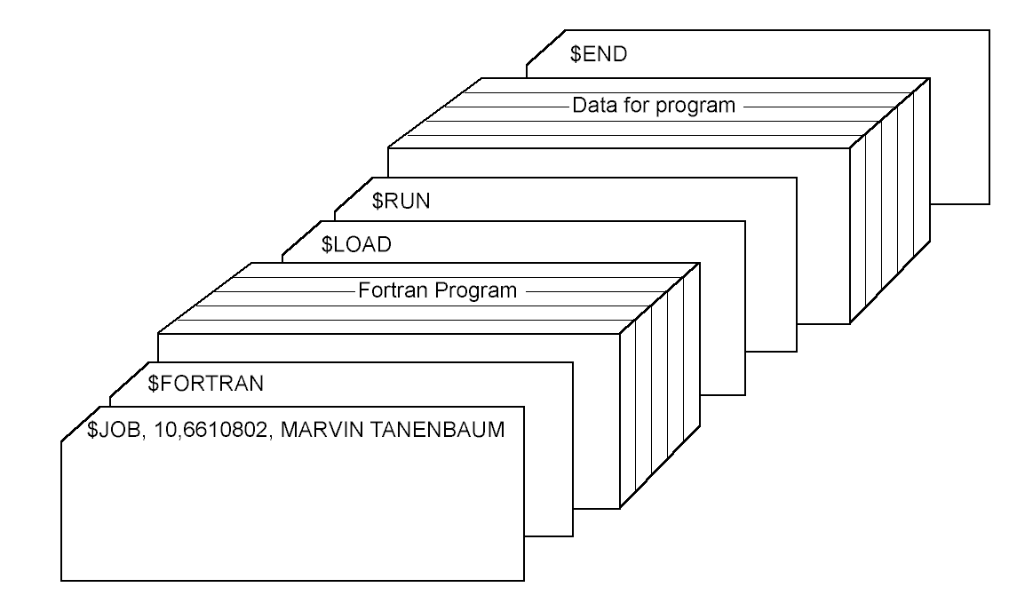
History of Operating Systems
Structure of a typical FMS job – 2nd generation

Slide 7

History of Operating Systems
Multiprogramming system
  three jobs in memory – 3rd generation

Slide 8
The Operating System Zoo
Mainframe operating systems
Server operating systems
Multiprocessor operating systems
Personal computer operating systems
Real-time operating systems
Embedded operating systems
Smart card operating systems

Slide 9

Computer Hardware Review
Monitor
Bus
Components of a simple personal computer

Slide 10
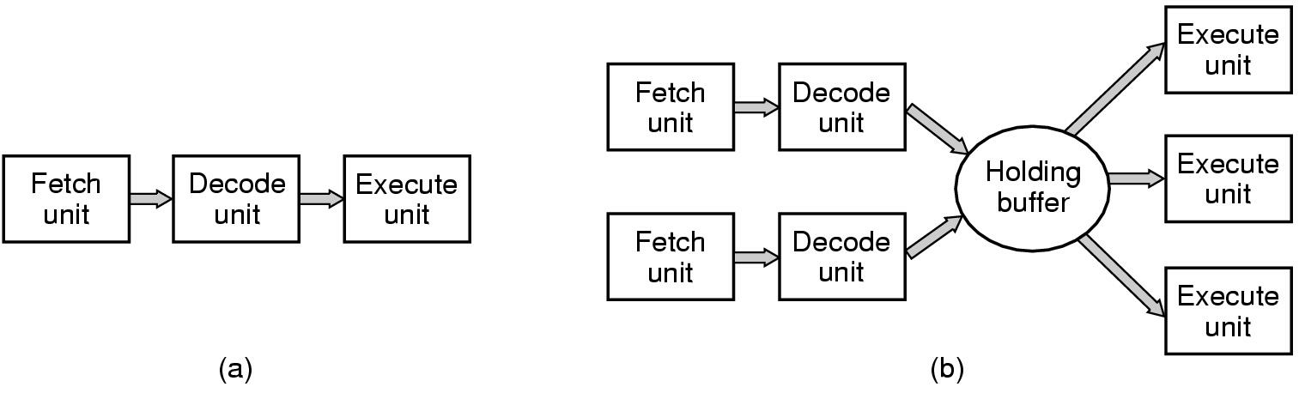
Computer Hardware Review
(a) A three-stage pipeline
(b) A superscalar CPU

Slide 11
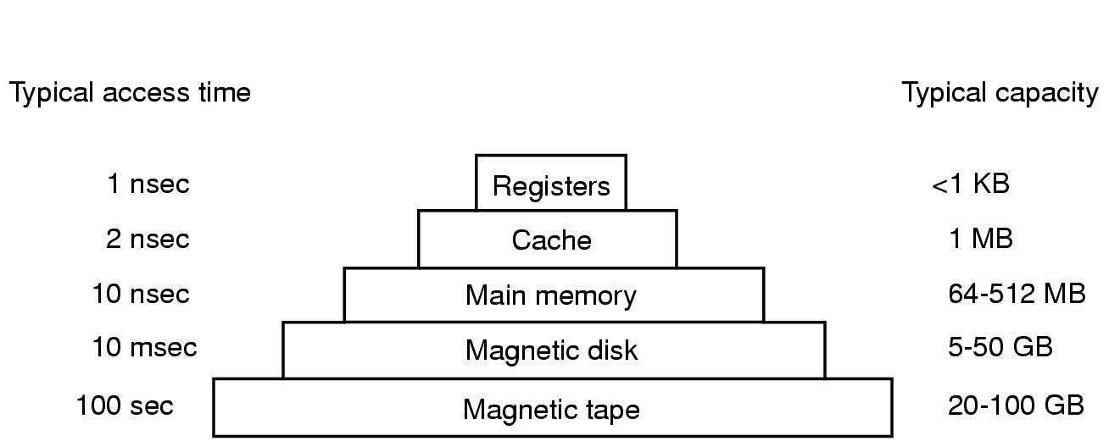
Computer Hardware Review
Typical memory hierarchy
  numbers shown are rough approximations

Slide 12
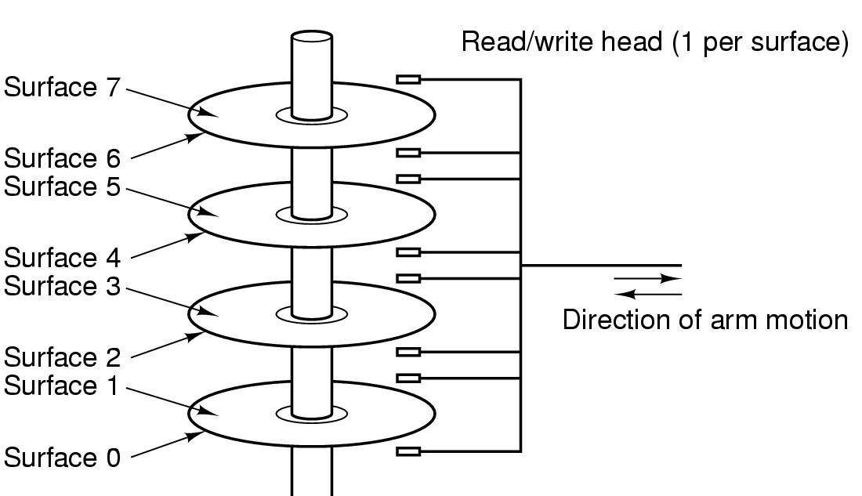
Computer Hardware Review
Structure of a disk drive

Slide 13
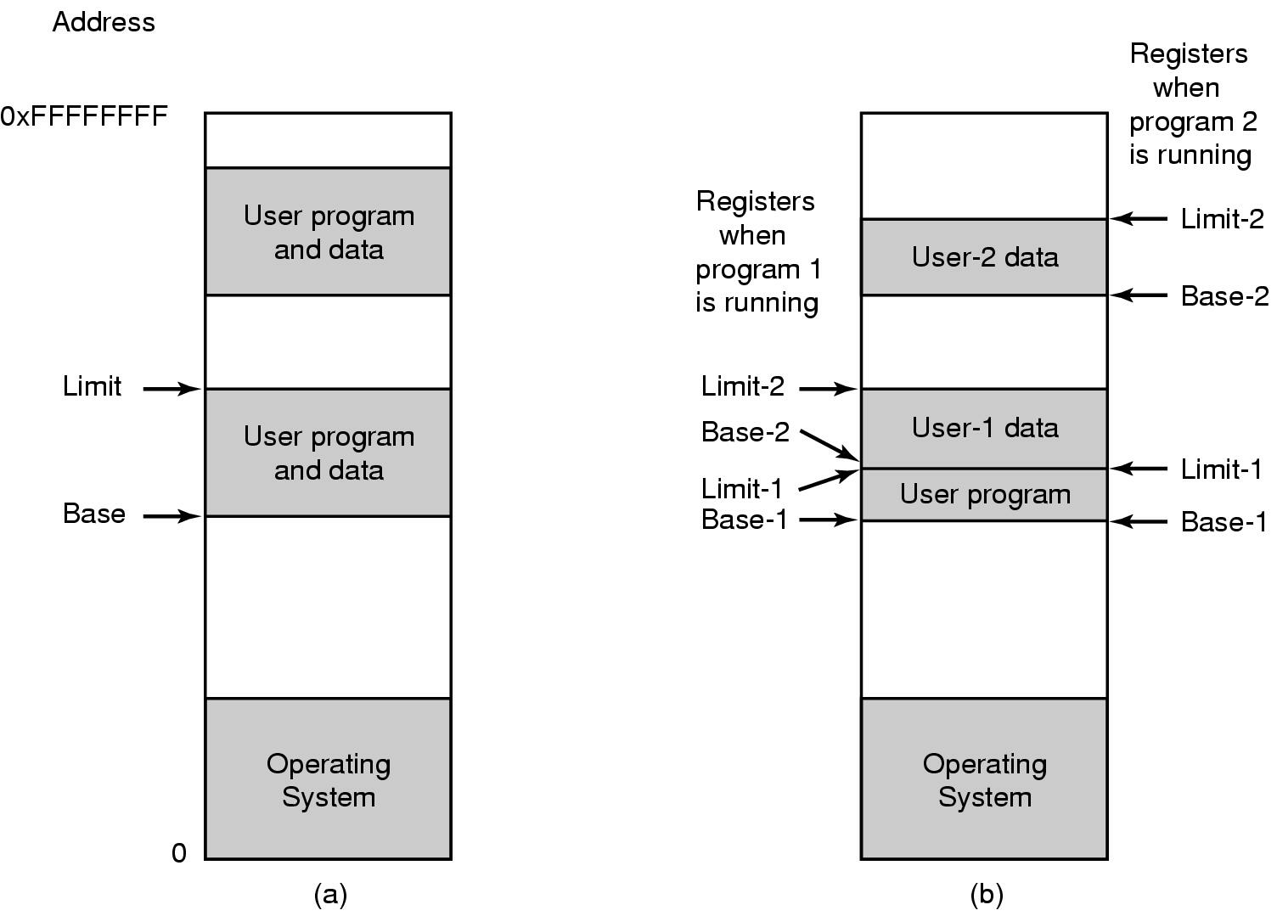
Computer Hardware Review
One base-limit pair and two base-limit pairs

Slide 14
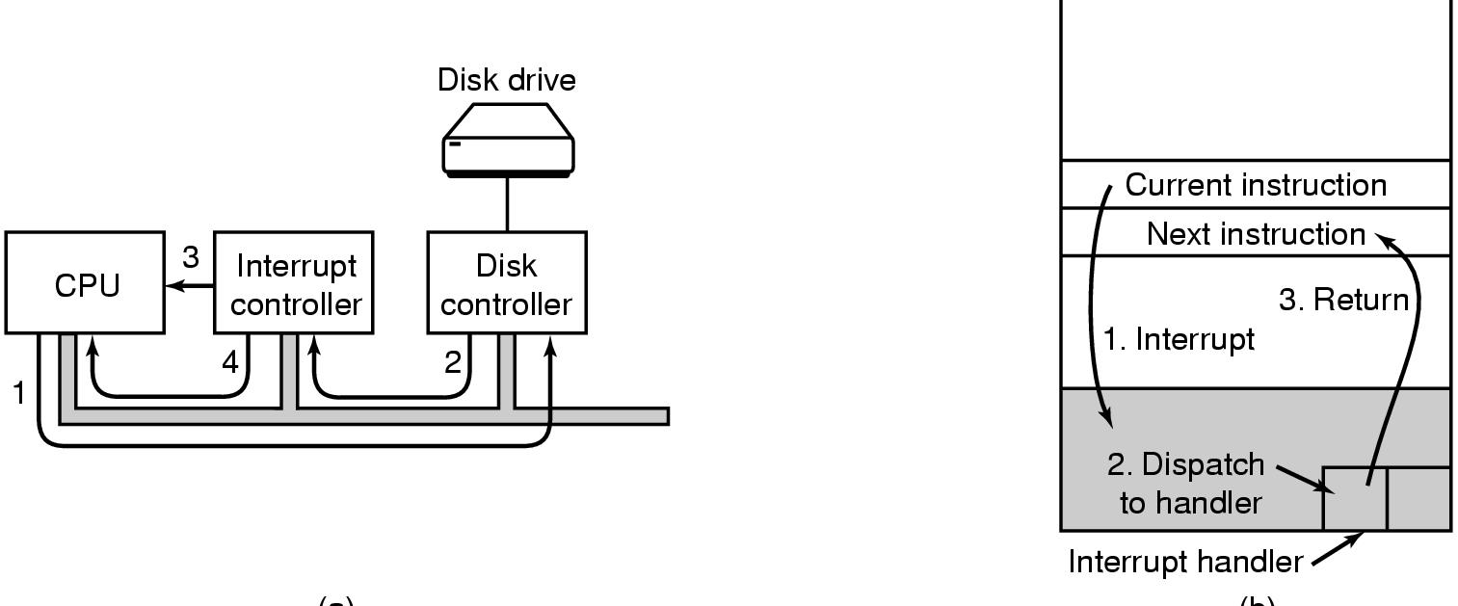
Computer Hardware Review
(a)
(b)
(a) Steps in starting an I/O device and getting interrupt
(b) How the CPU is interrupted

Slide 15

Computer Hardware Review
Structure of a large Pentium system

Slide 16

Operating System Concepts (1)
A process tree
  A created two child processes, B and C
  B created three child processes, D, E, and F

Slide 17
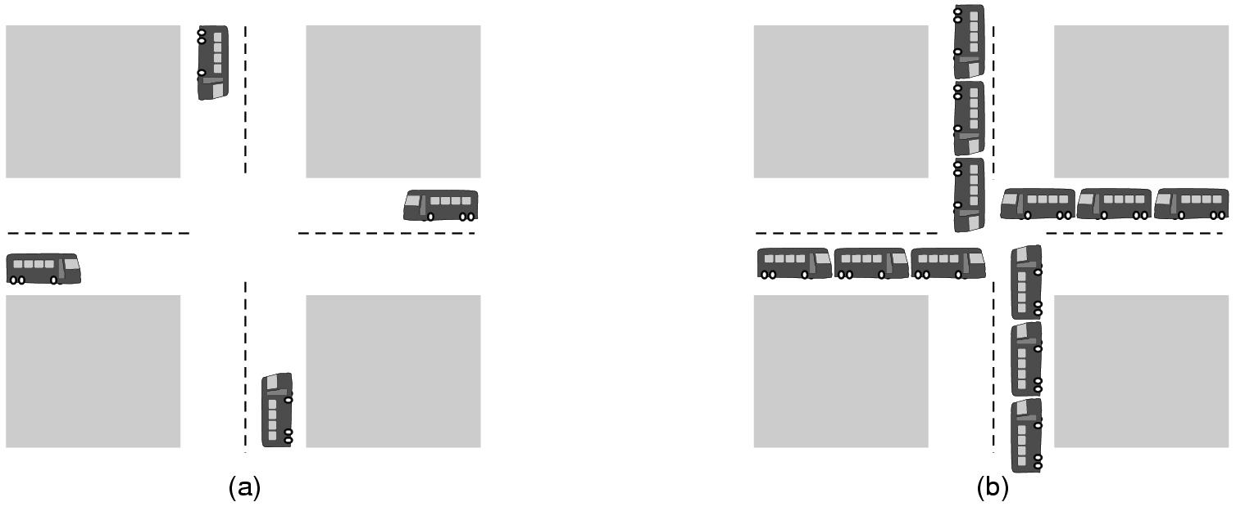
Operating System Concepts (2)
(a) A potential deadlock. (b) an actual deadlock.

Slide 18
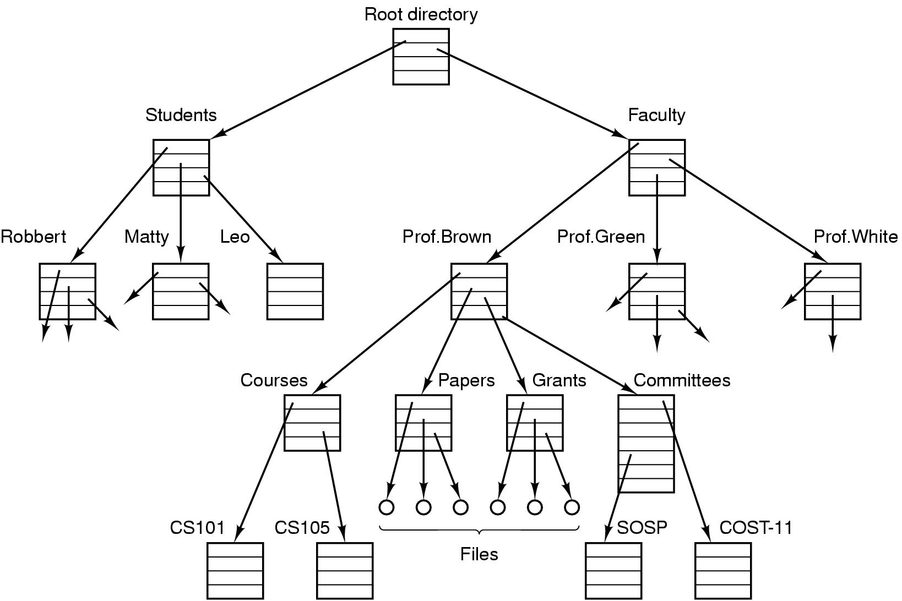
Operating System Concepts (3)
File system for a university department

Slide 19
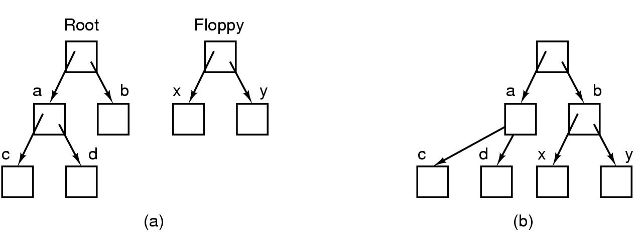
Operating System Concepts (4)
Before mounting,
  files on floppy are inaccessible
After mounting floppy on b,
  files on floppy are part of file hierarchy

Slide 20
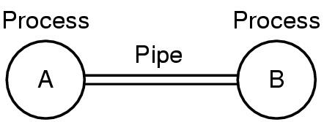
Operating System Concepts (5)
Two processes connected by a pipe

Slide 21

Steps in Making a System Call
There are 11 steps in making the system call
read (fd, buffer, nbytes)

Slide 22
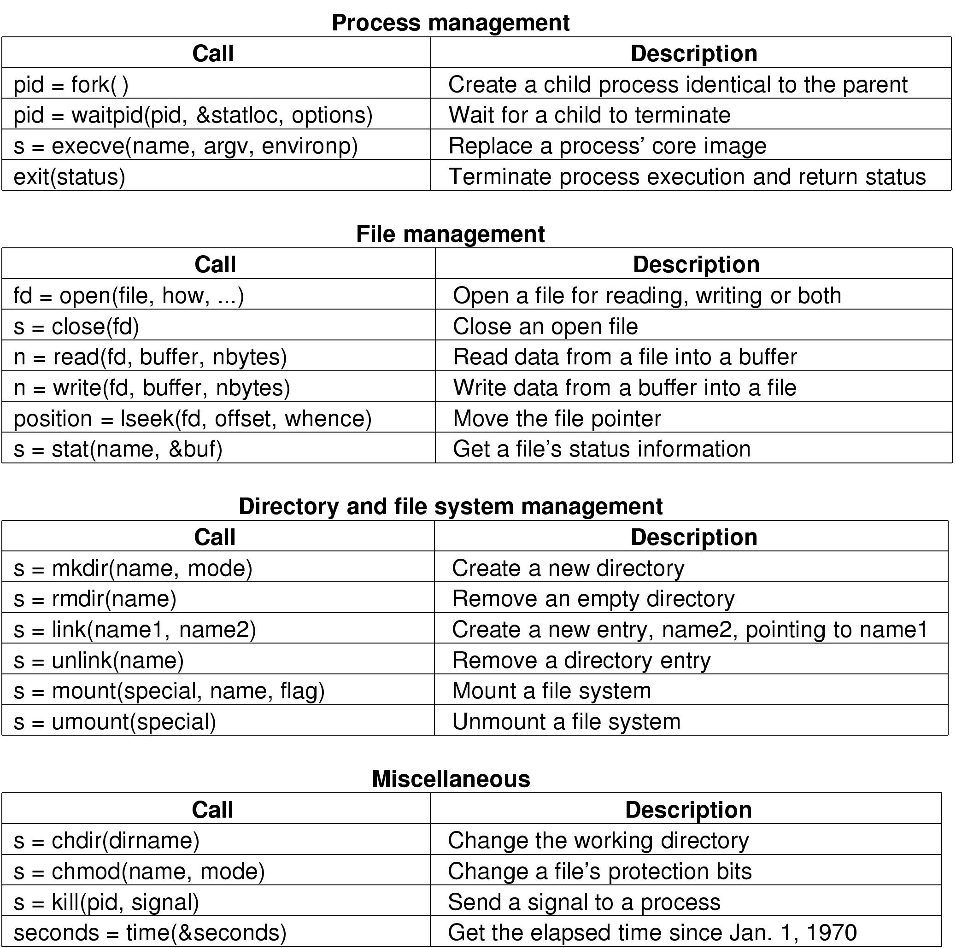
Some System Calls For Process Management

Slide 23
Some System Calls For File Management

Slide 24
Some System Calls For Directory Management

Slide 25
Some System Calls For Miscellaneous Tasks

Slide 26
System Calls (1)
A stripped down shell:
while (TRUE) { /* repeat forever */
type_prompt( ); /* display prompt */
read_command (command, parameters) /* input from terminal */
if (fork() != 0) { /* fork off child process */
/* Parent code */
waitpid( -1, &status, 0); /* wait for child to exit */
} else {
/* Child code */
execve (command, parameters, 0); /* execute command */
}
}

Slide 27
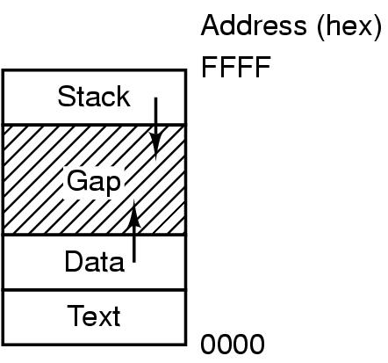
System Calls (2)
Processes have three segments: text, data, stack

Slide 28
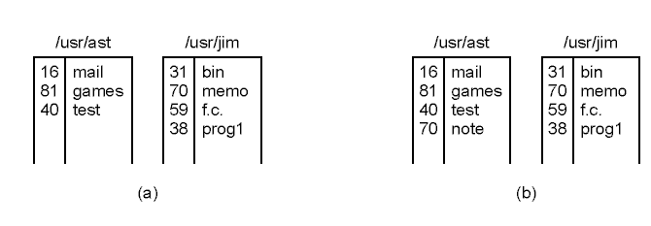
System Calls (3)
(a) Two directories before linking
/usr/jim/memo to ast's directory
(b) The same directories after linking

Slide 29
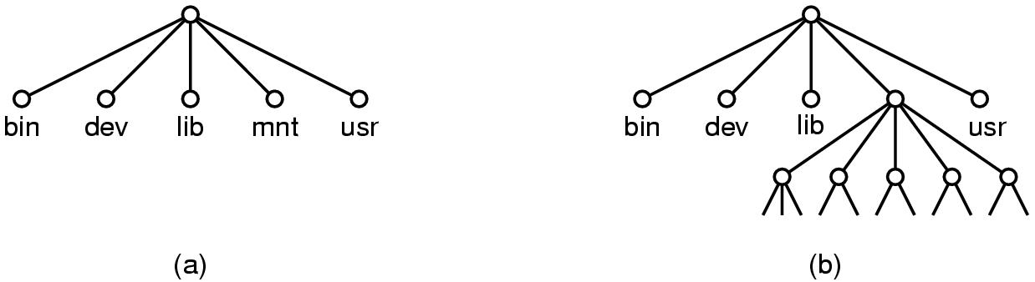
System Calls (4)
(a) File system before the mount
(b) File system after the mount

Slide 30
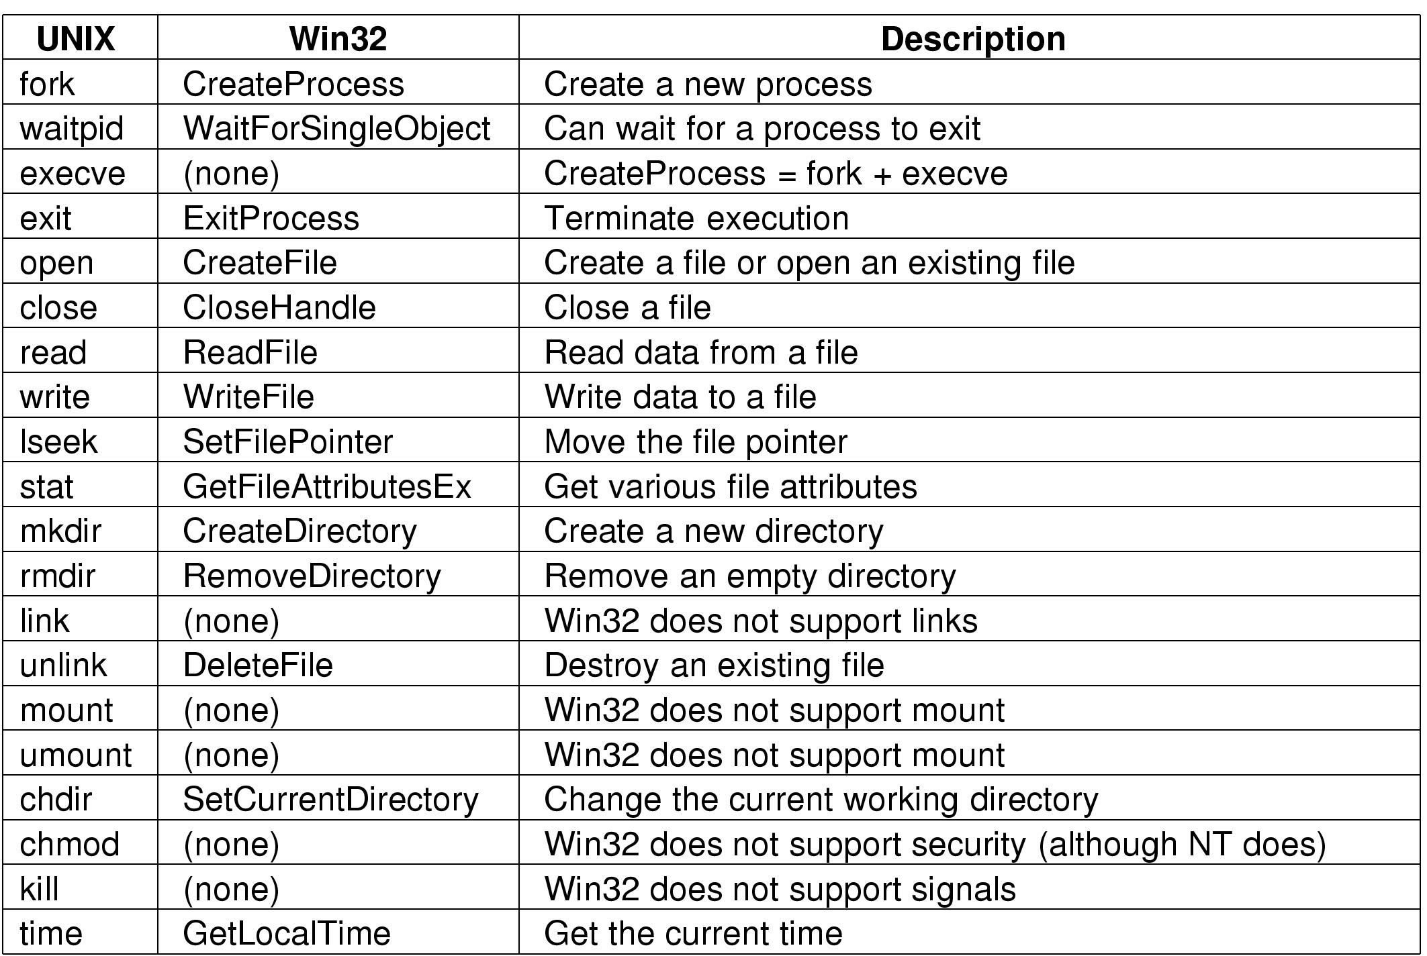
System Calls (5)
Some Win32 API calls

Slide 31
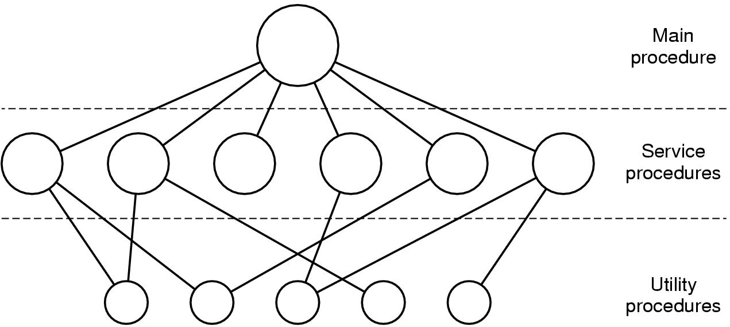
Operating System Structure (1)
Simple structuring model for a monolithic system

Slide 32
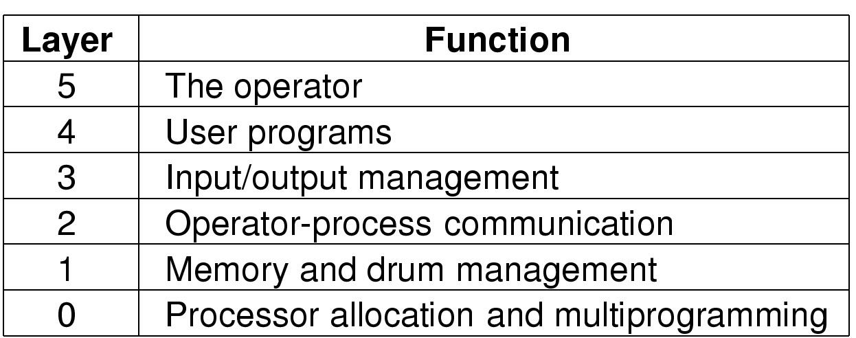
Operating System Structure (2)
Structure of the THE operating system

Slide 33
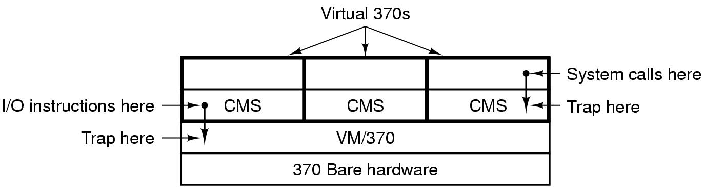
Operating System Structure (3)
Structure of VM/370 with CMS

Slide 34
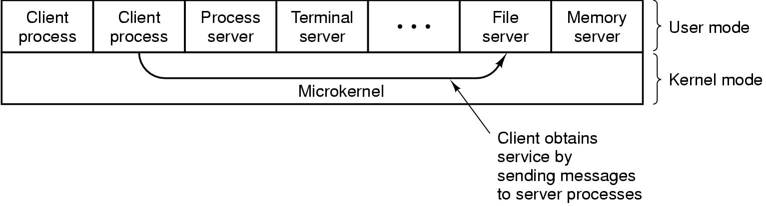
Operating System Structure (4)
The client-server model

Slide 35
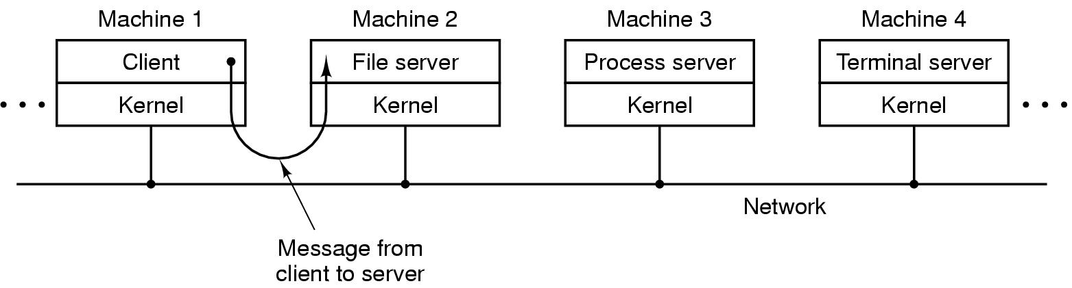
Operating System Structure (5)
The client-server model in a distributed system

Slide 36
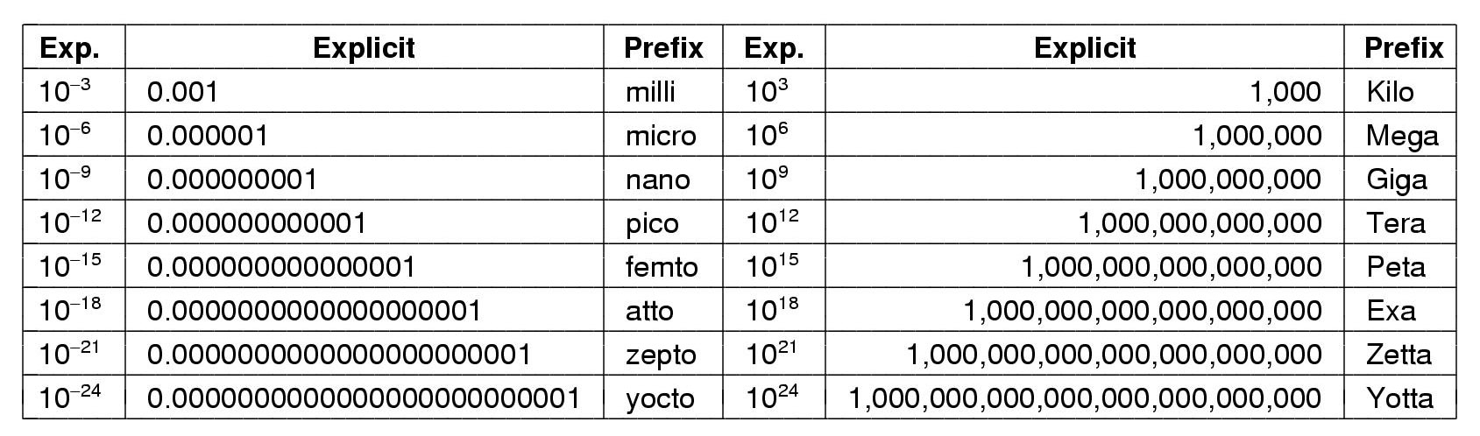
Metric Units
The metric prefixes

